Slide 1

Before We Continue
Click to Begin

Slide 2
Error!
Please follow the on-screen
instructions to continue.
Go Back

Slide 3
Complete
Please navigate to the next module
in the course to continue.
Restart Course

Slide 4
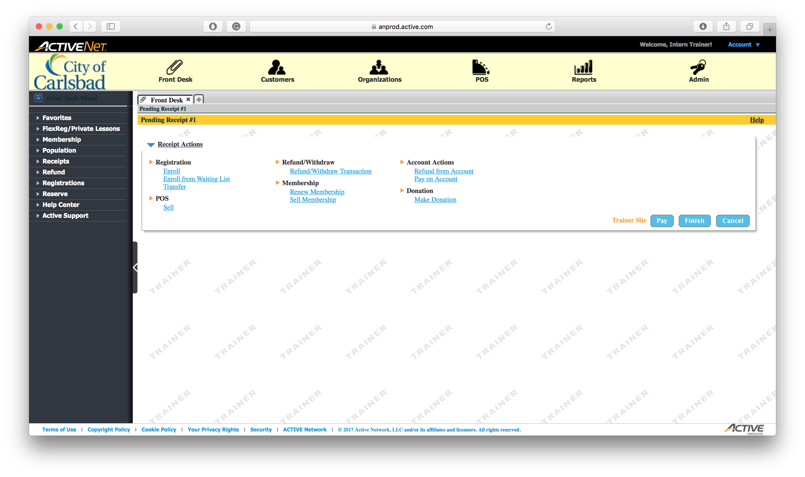
Tip:
Select the Reports module
This is where we print all reports

Slide 5
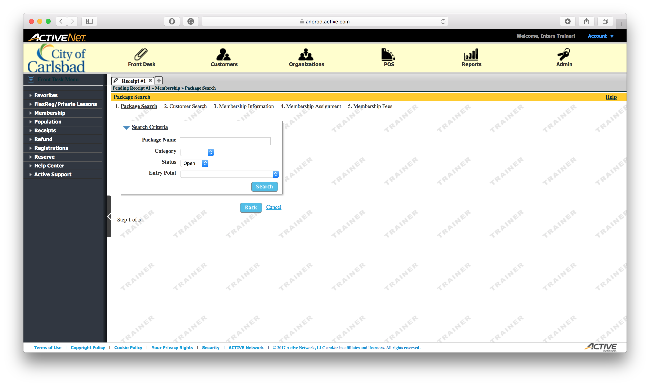
Tip:
Select the Reports module
This is where we print all reports

Slide 6

Tip:
Select the Reports module
This is where we print all reports

Slide 7
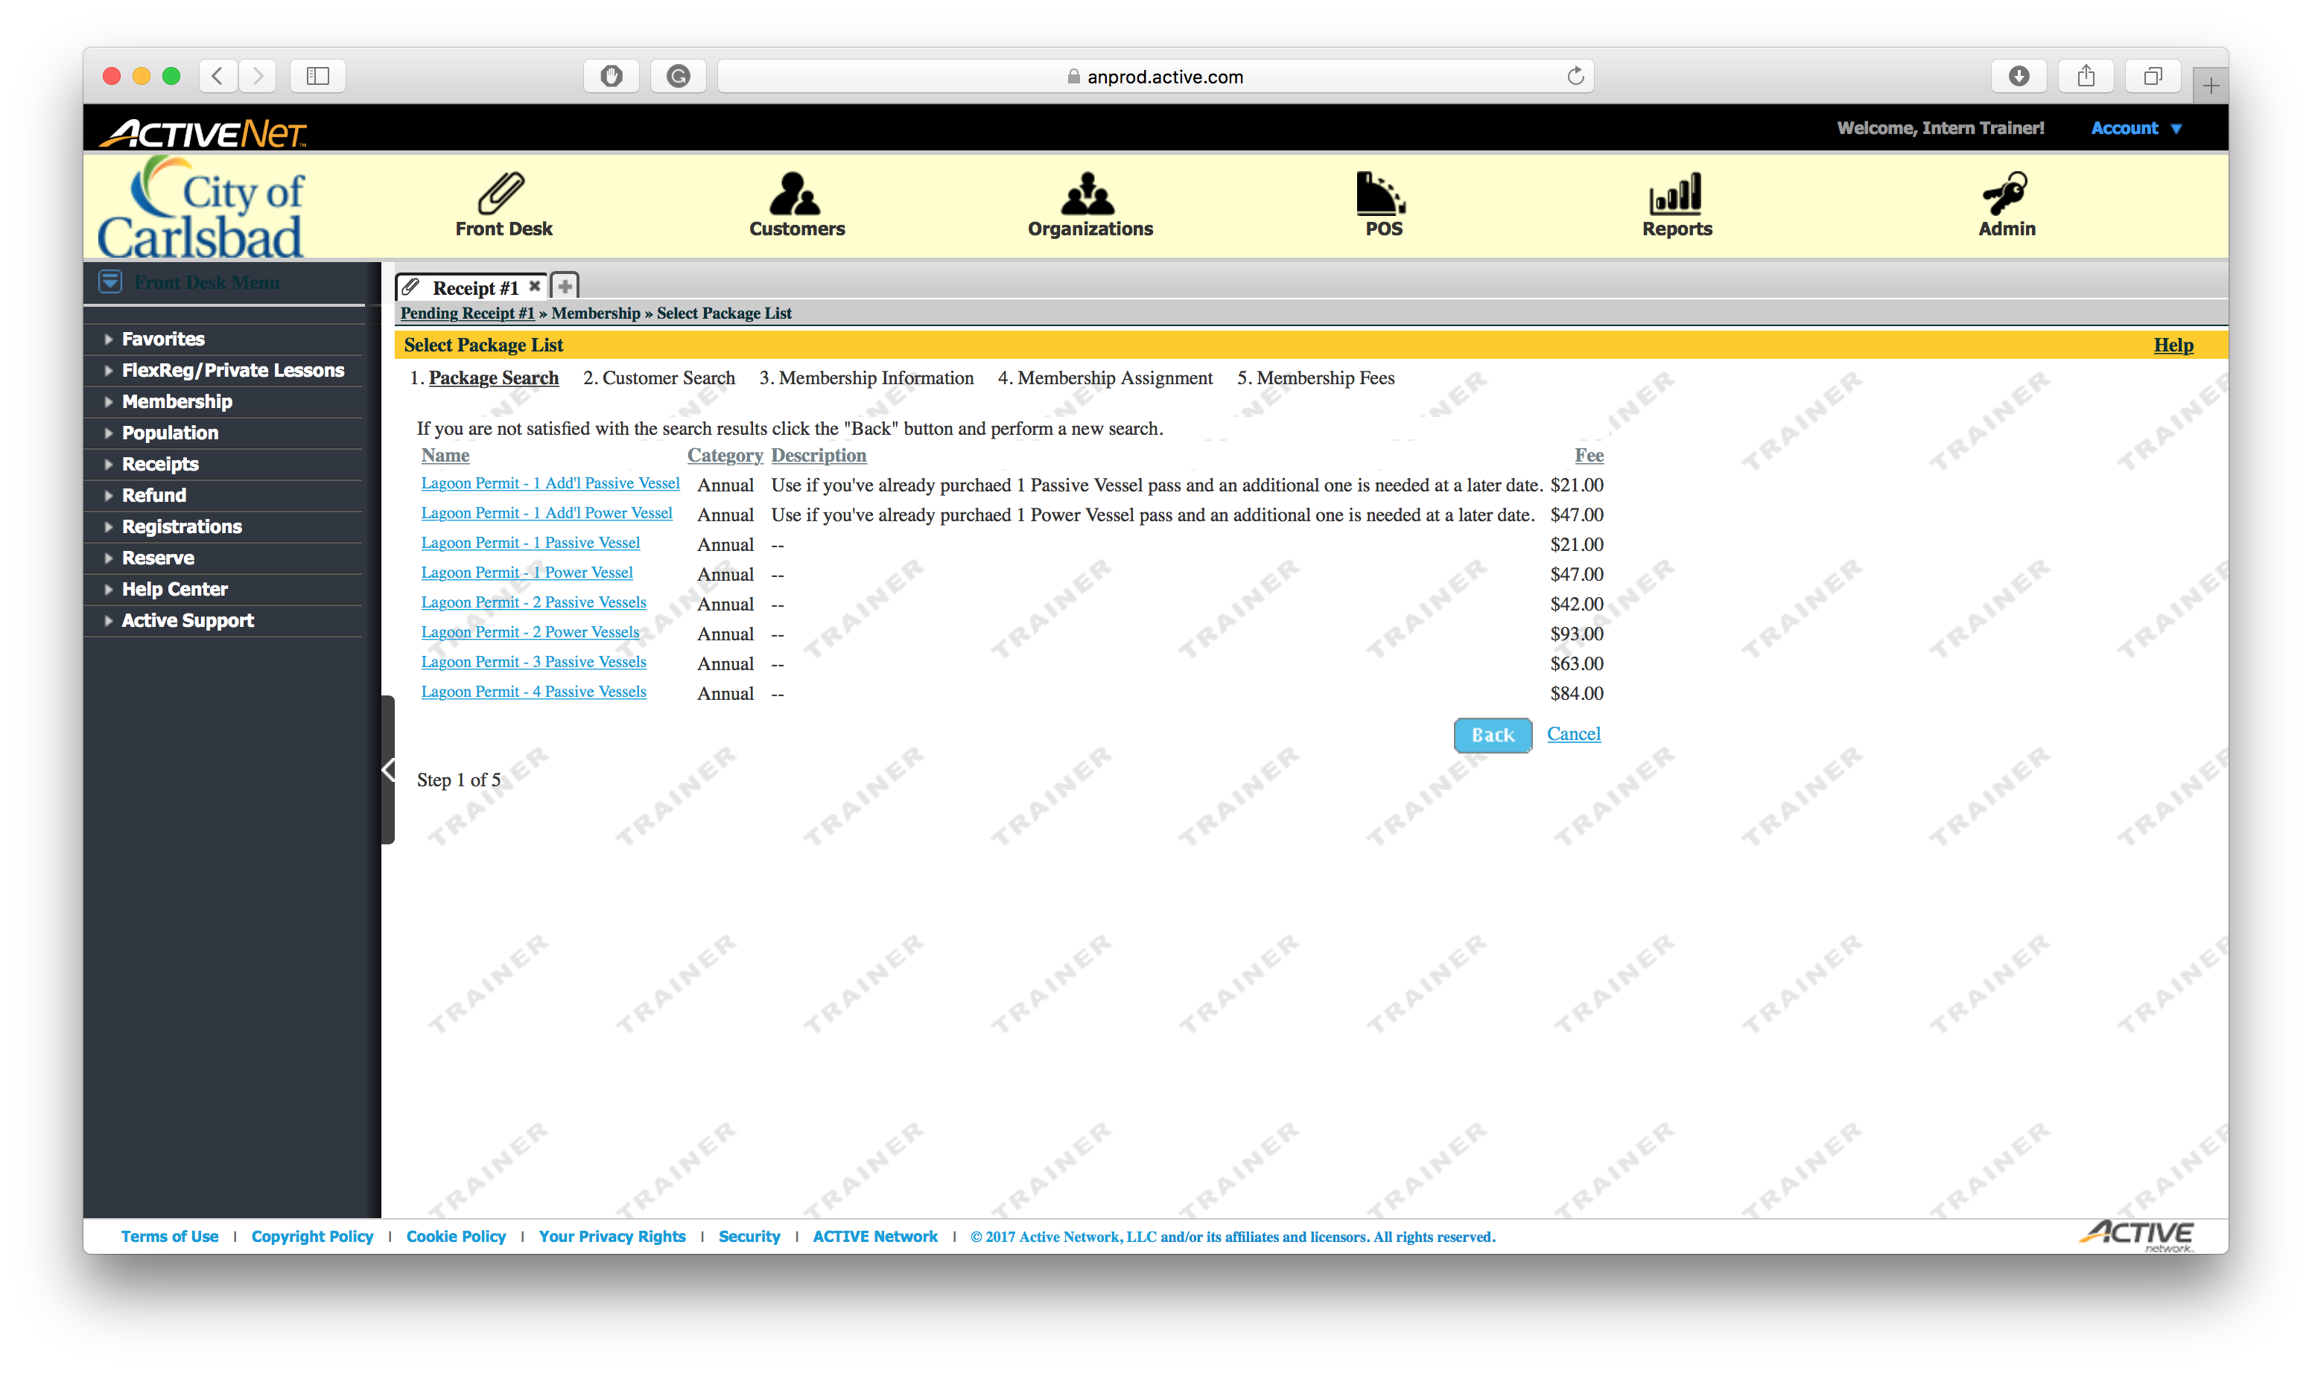
Tip:
Select the Reports module
This is where we print all reports

Slide 8
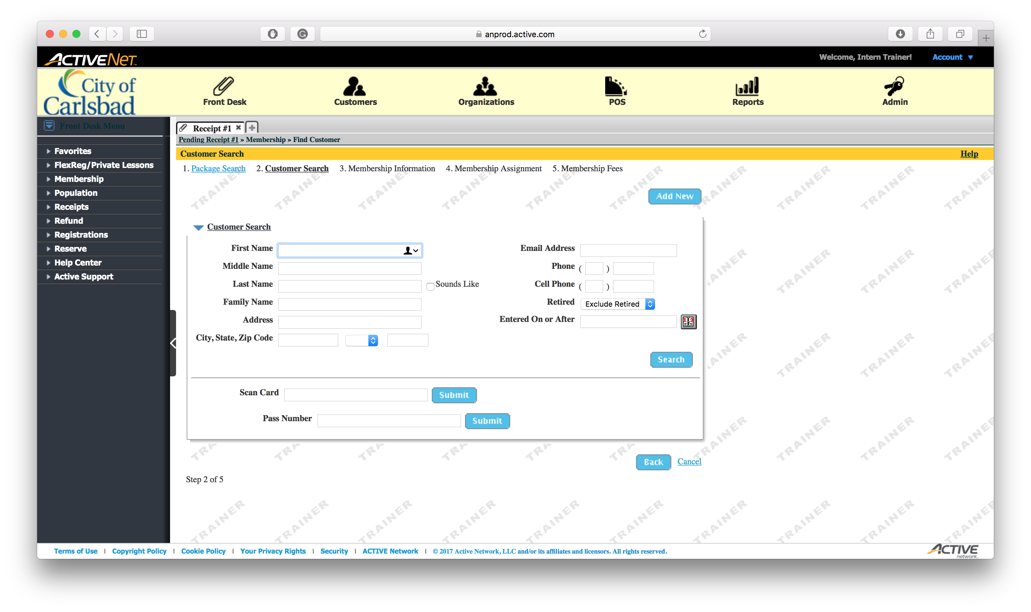
Tip:
Select the Reports module
This is where we print all reports

Slide 9

Tip:
Select the Reports module
This is where we print all reports

Slide 10

Tip:
Select the Reports module
This is where we print all reports

Slide 11
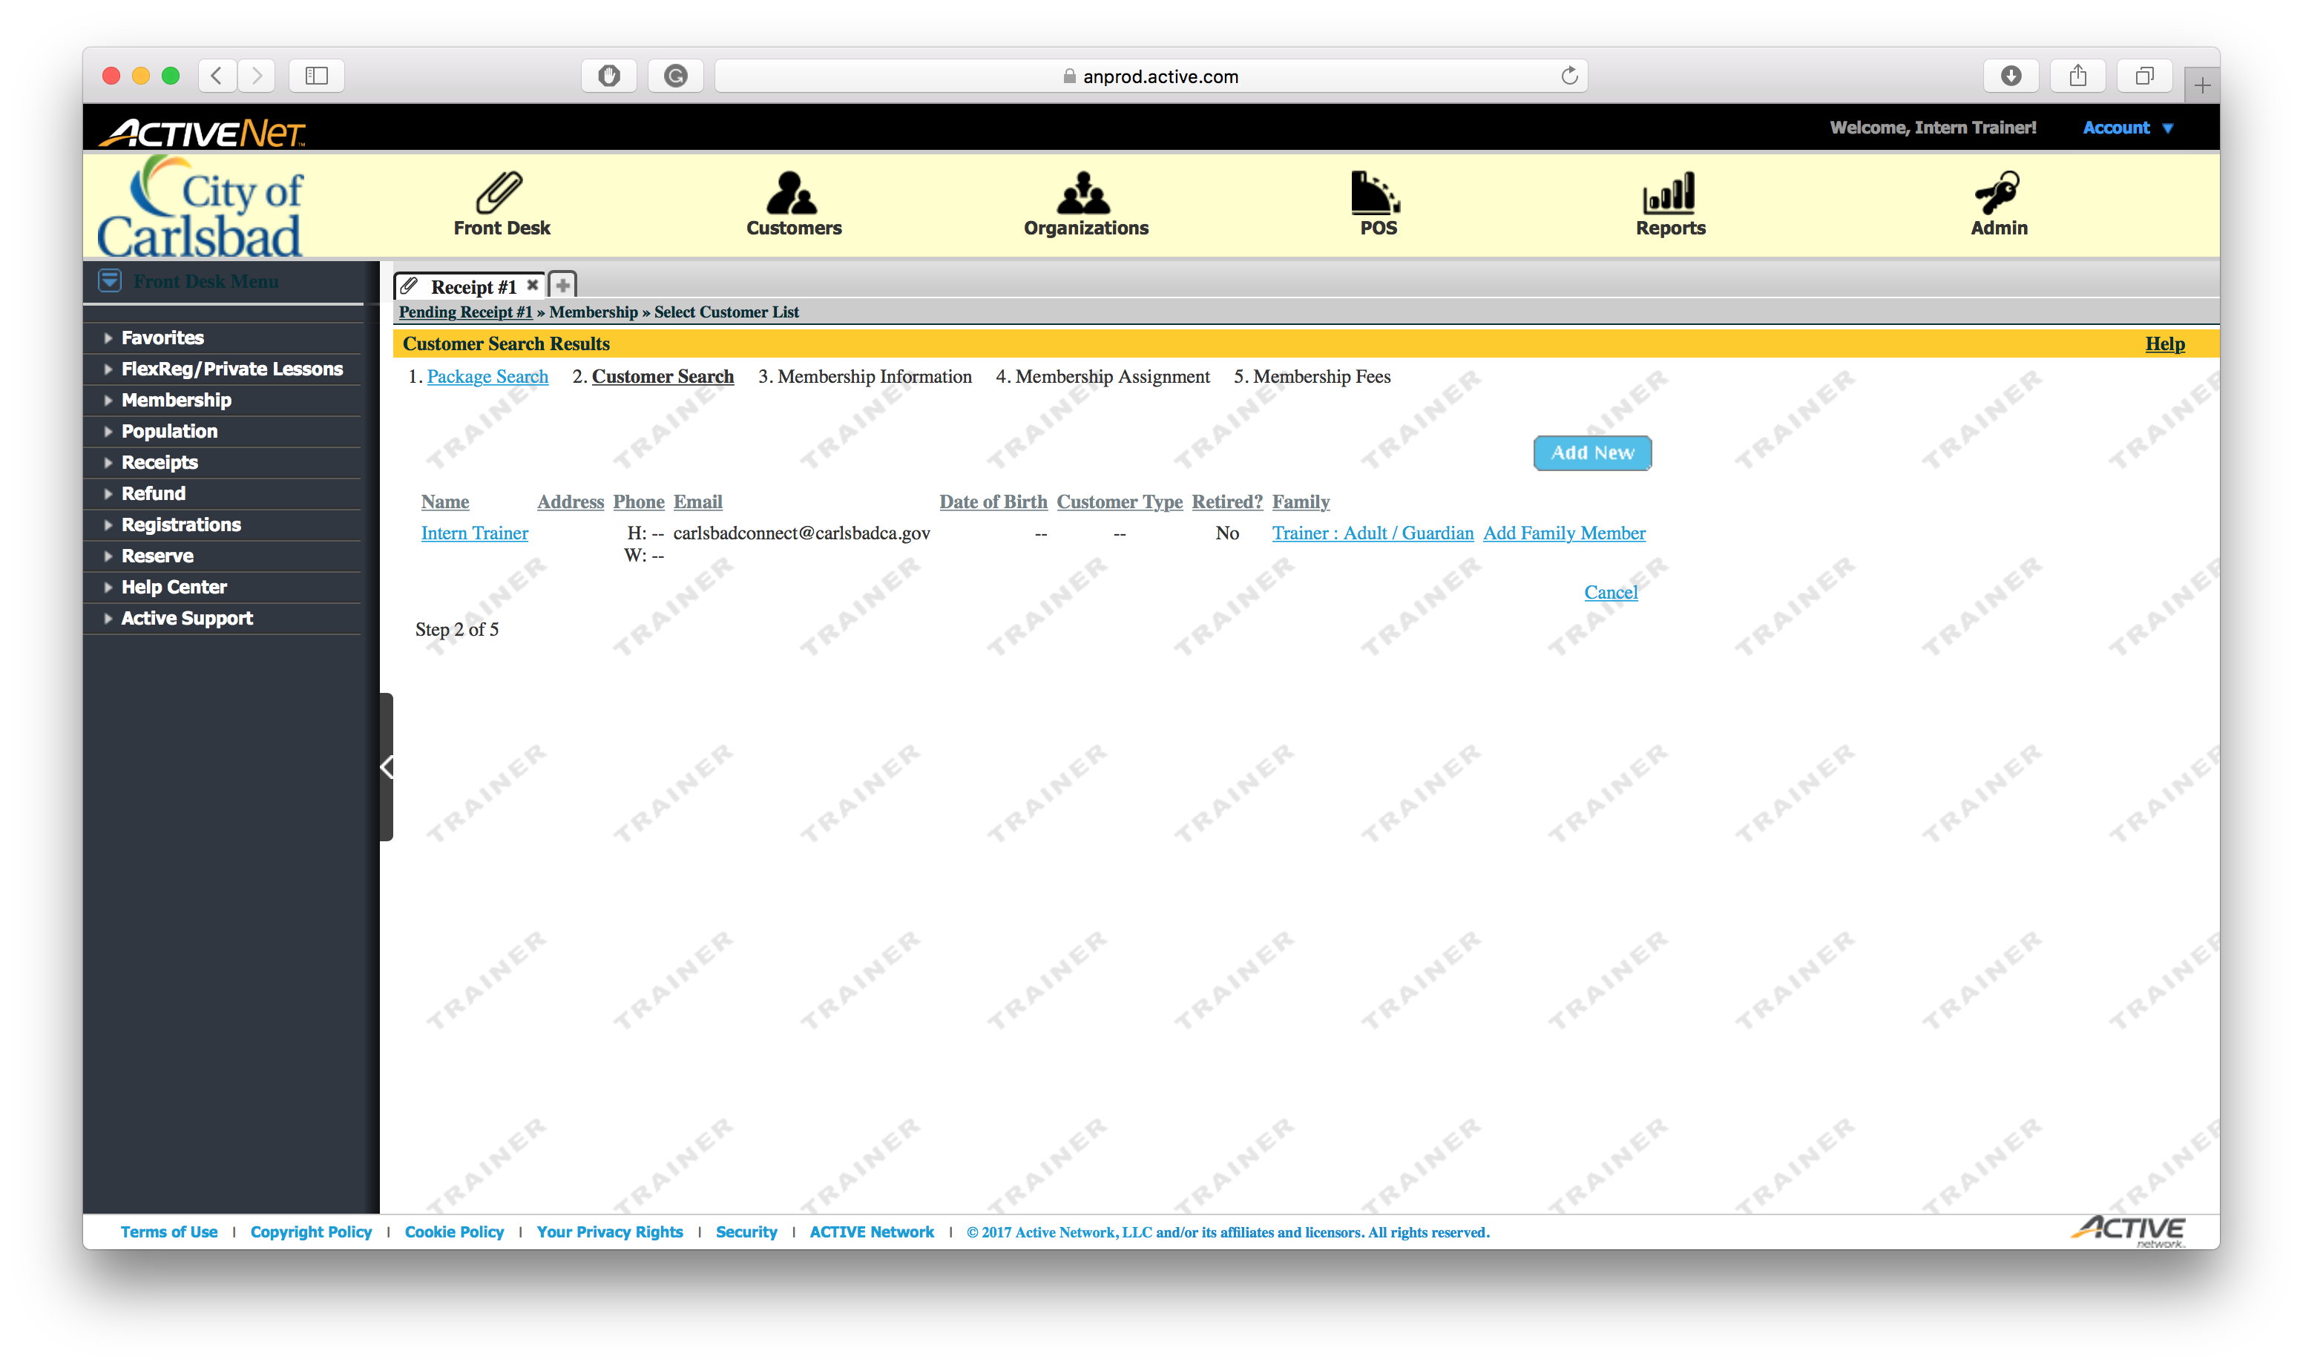
Tip:
Select the Reports module
This is where we print all reports

Slide 12
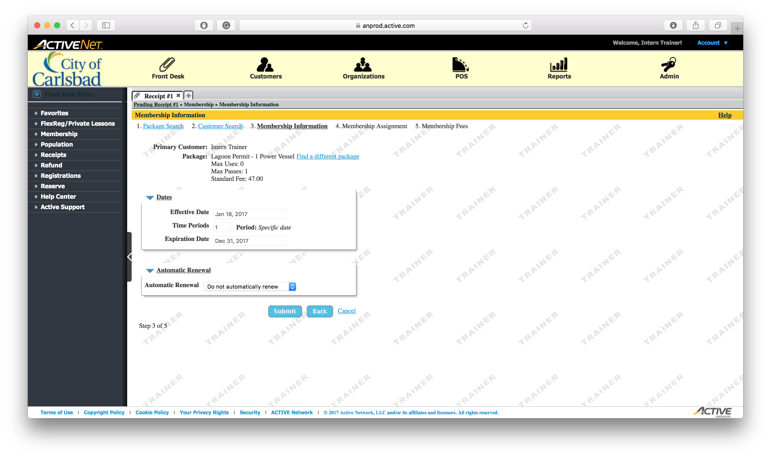
Tip:
Select the Reports module
This is where we print all reports

Slide 13
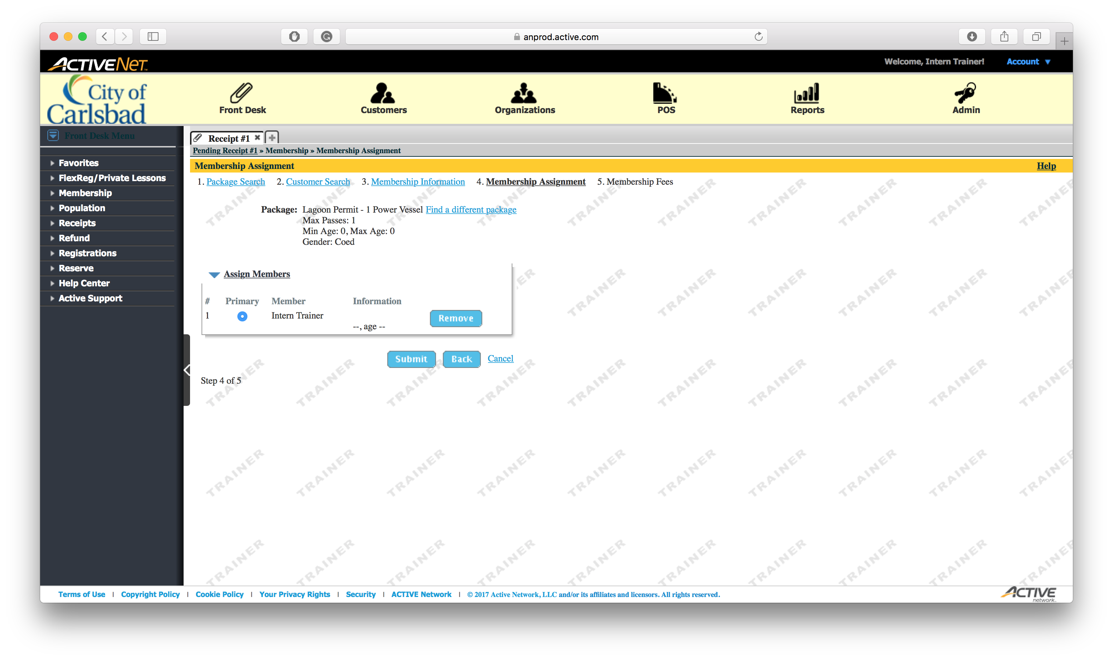
Tip:
Select the Reports module
This is where we print all reports

Slide 14
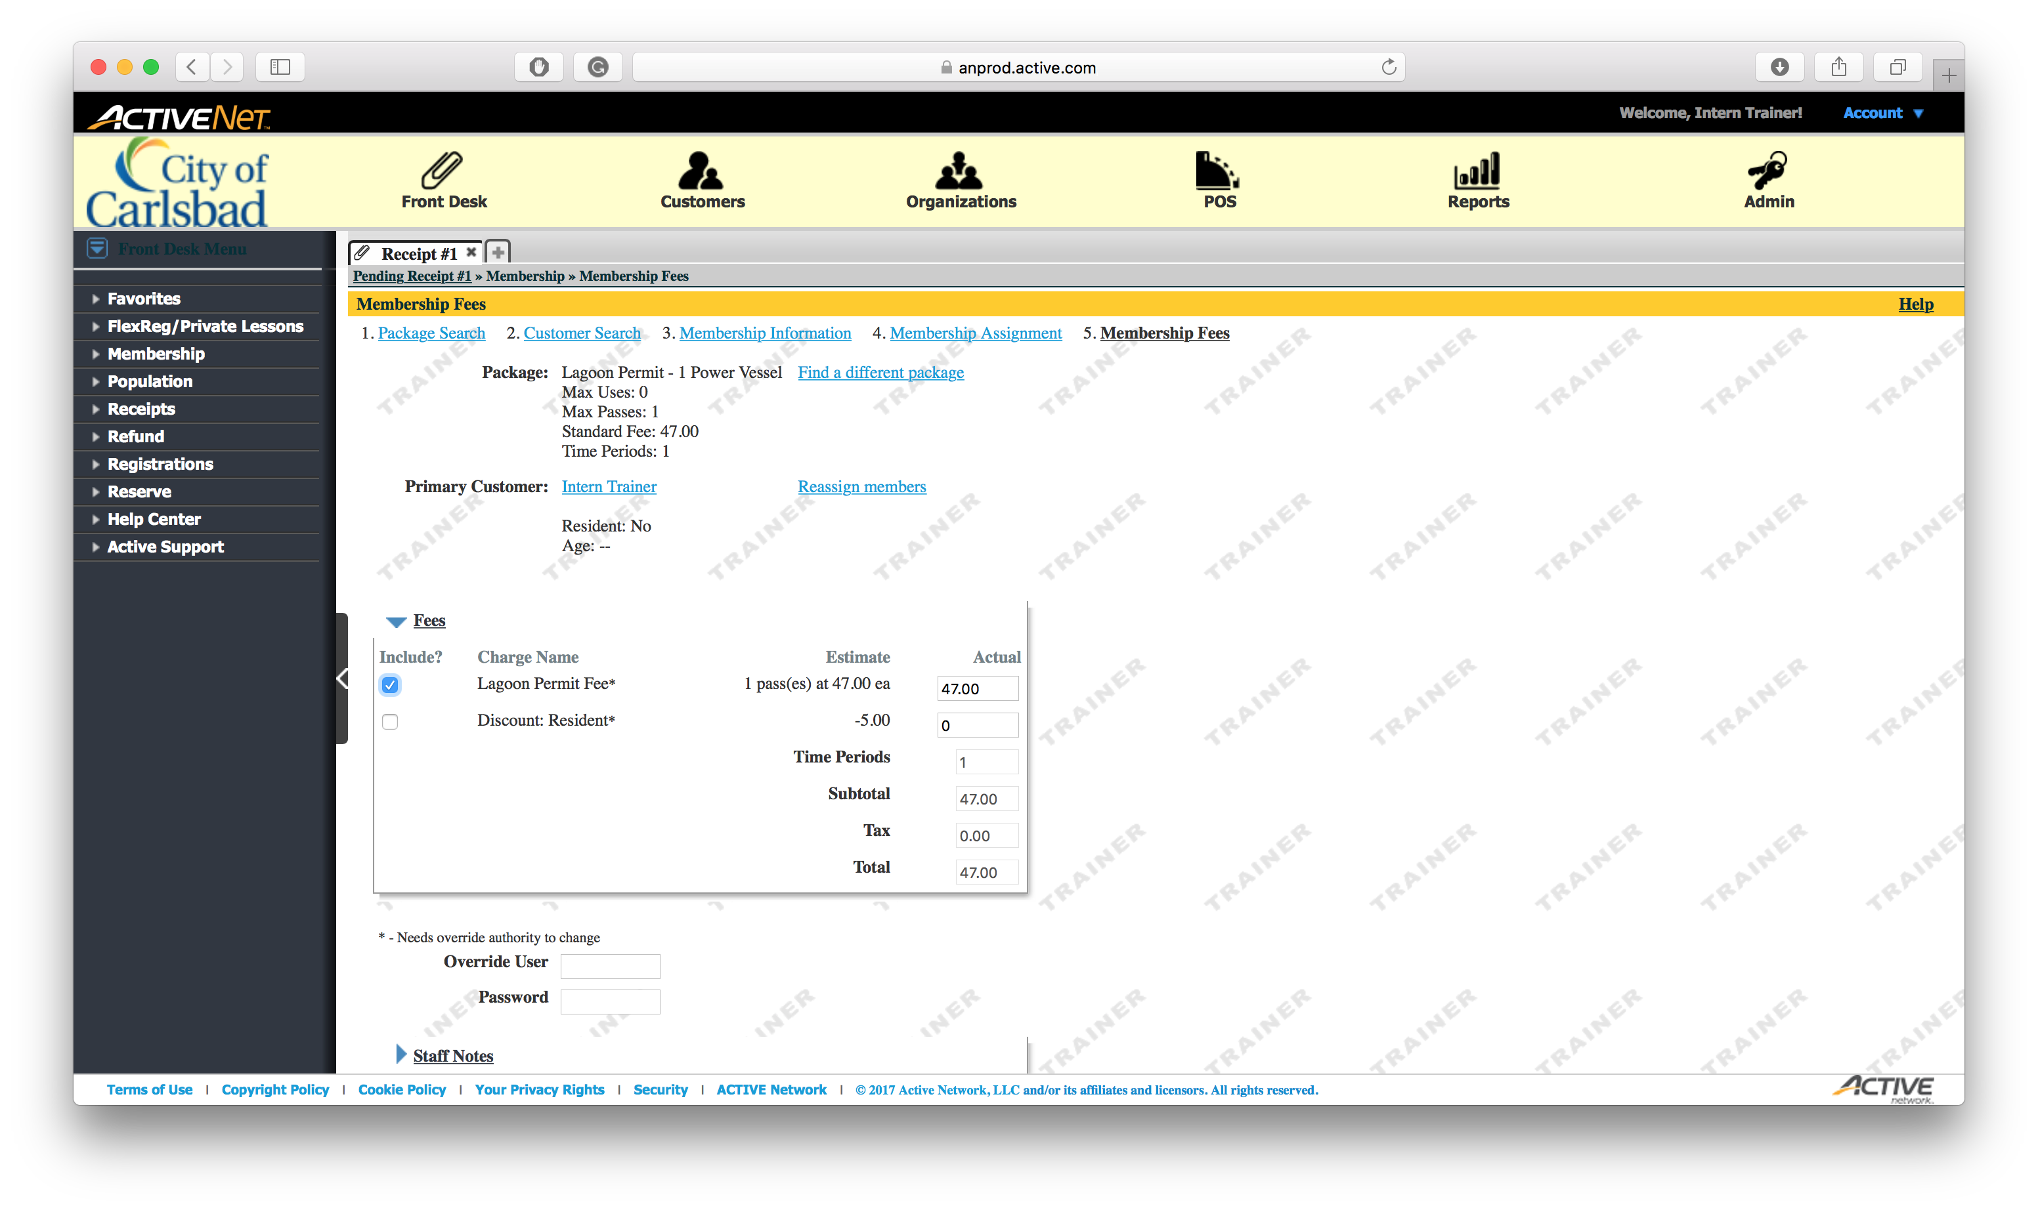
Tip:
Select the Reports module
This is where we print all reports

Slide 15
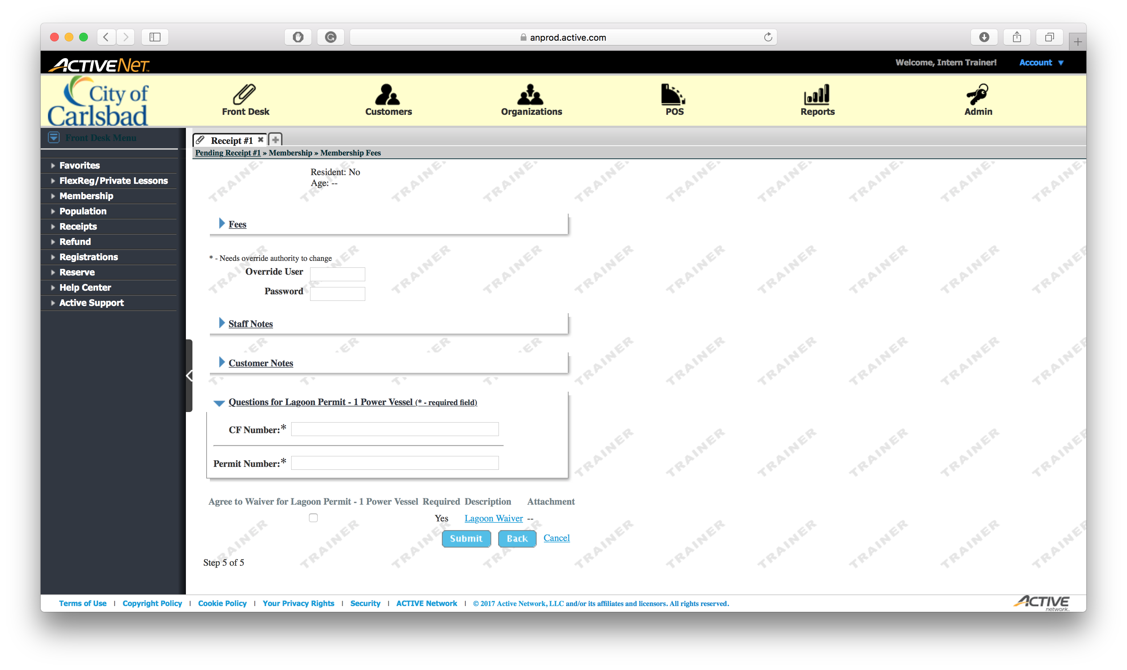
Tip:
Select the Reports module
This is where we print all reports

Slide 16

Tip:
Select the Reports module
This is where we print all reports

Slide 17

Tip:
Select the Reports module
This is where we print all reports

Slide 18

Tip:
Select the Reports module
This is where we print all reports

Slide 19
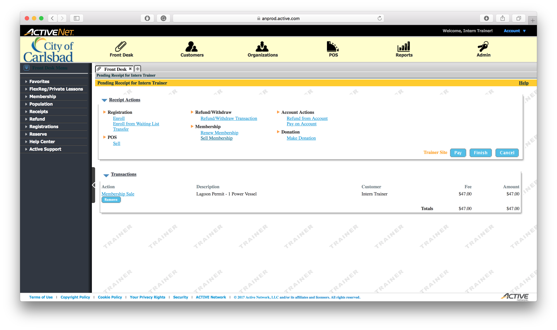
Tip:
Select the Reports module
This is where we print all reports

Slide 20
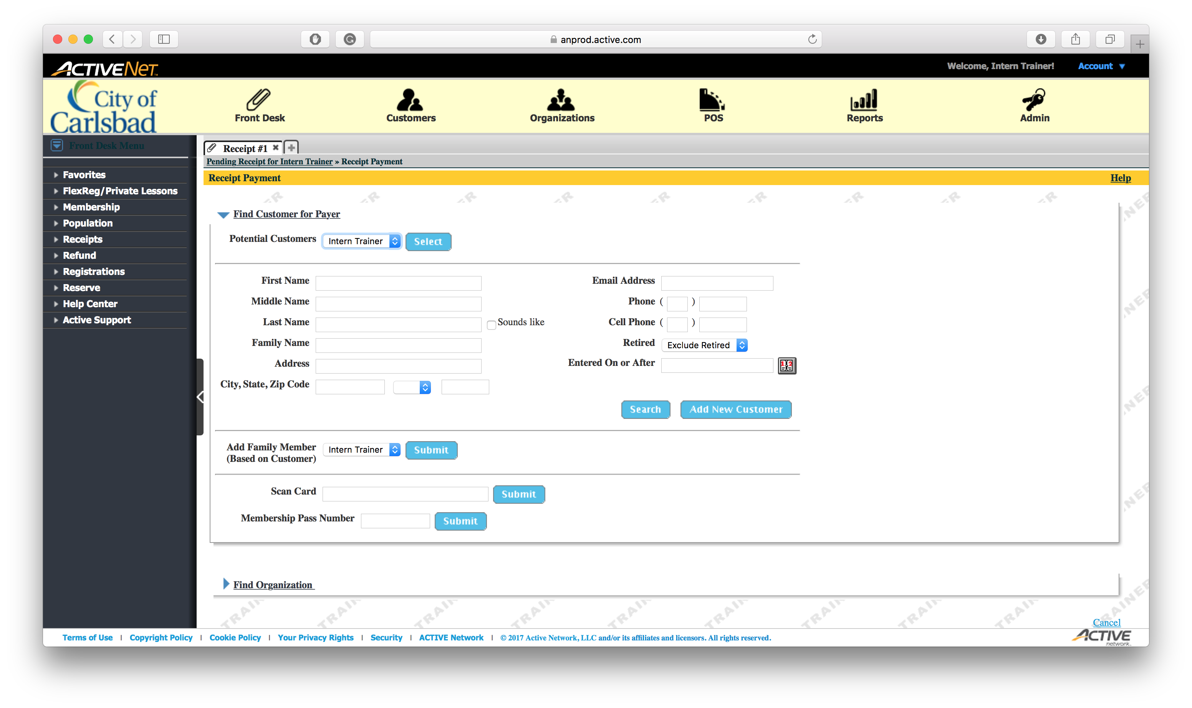
Tip:
Select the Reports module
This is where we print all reports

Slide 21
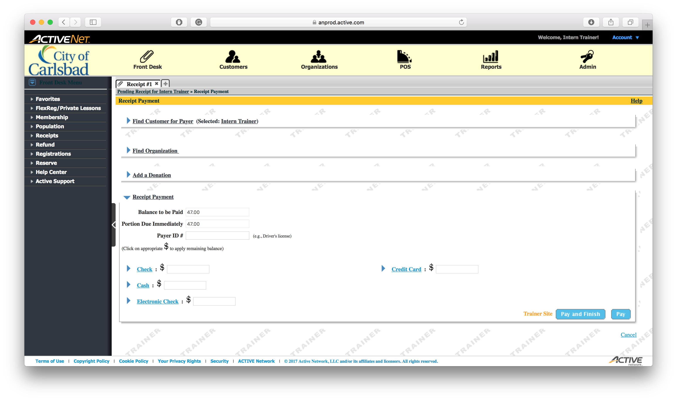
Tip:
Select the Reports module
This is where we print all reports

Slide 22
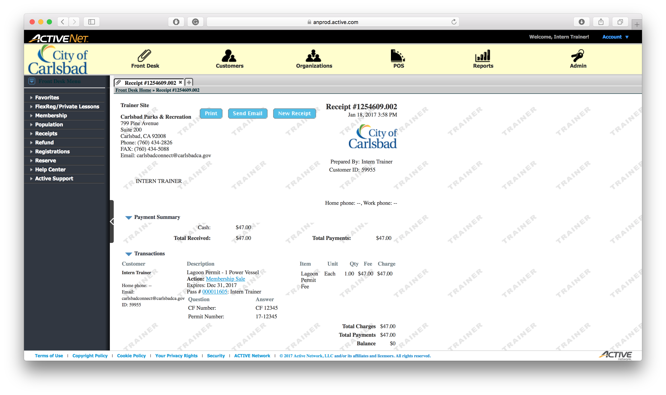
Tip:
Select the Reports module
This is where we print all reports

Slide 23
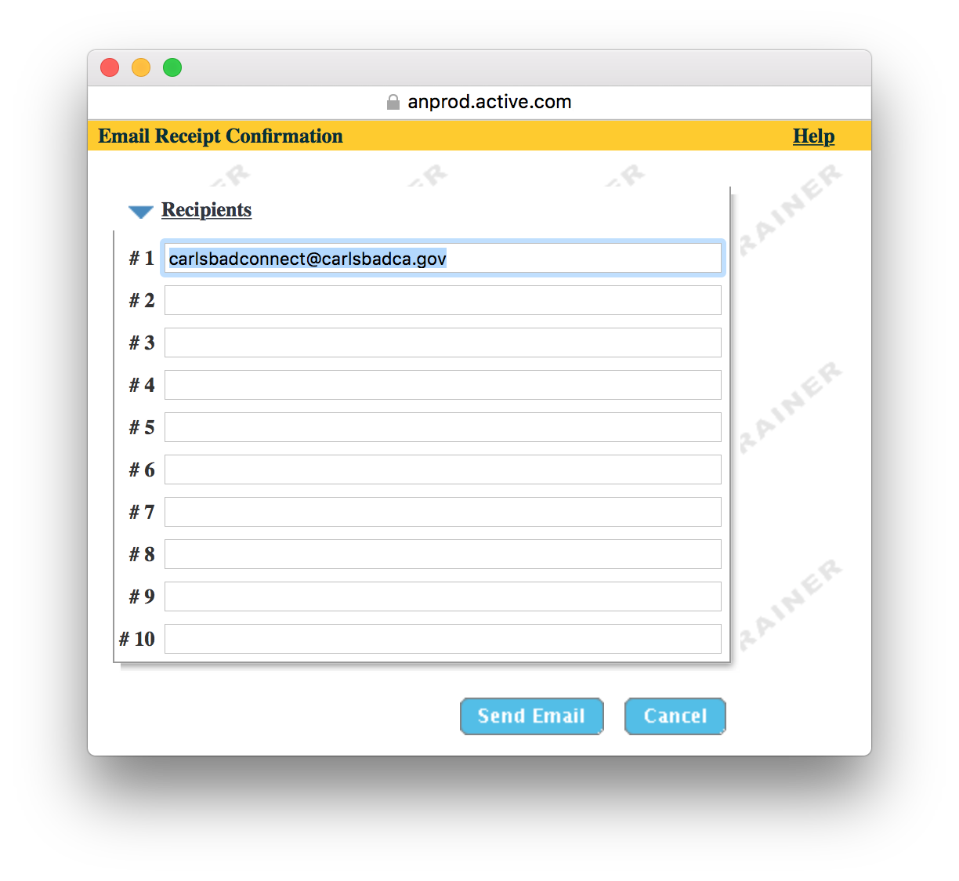
Tip:
Select the Reports module
This is where we print all reports

